Slide 2



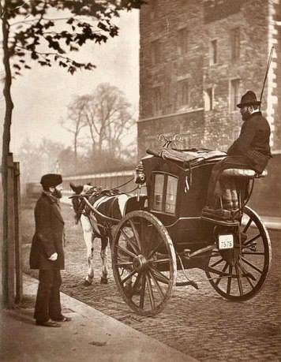
Source:
https://www.historic-uk.com/
https://Wikipedia.org

Slide 3
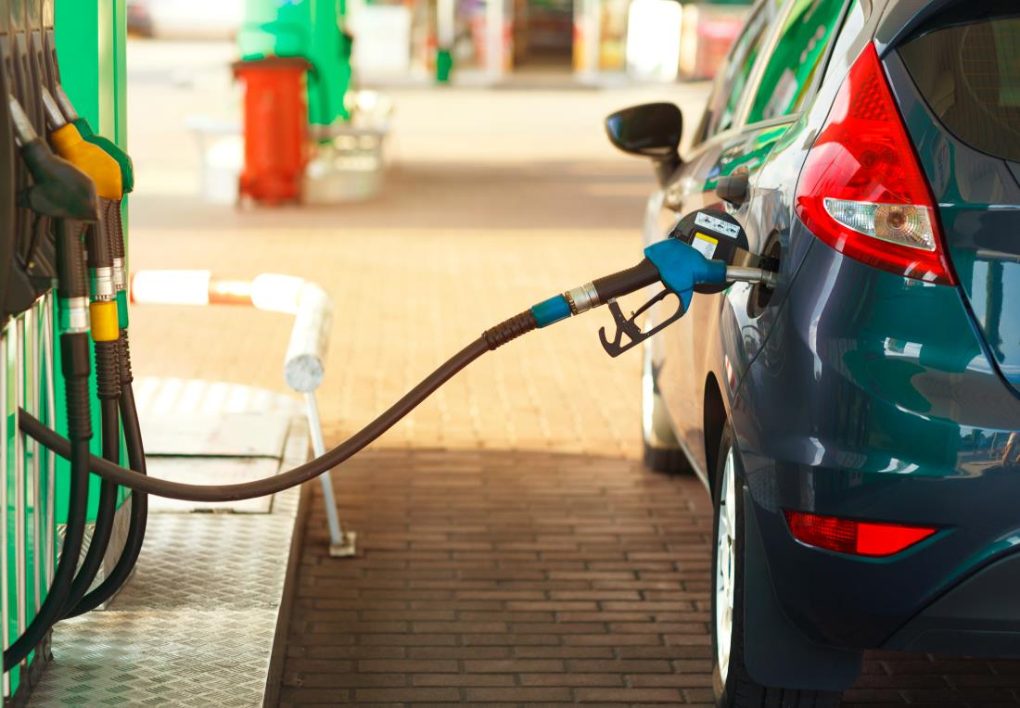
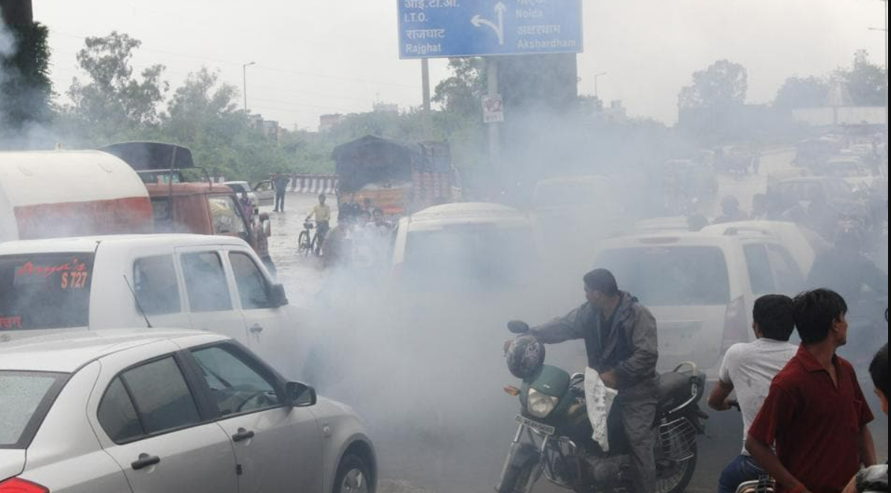
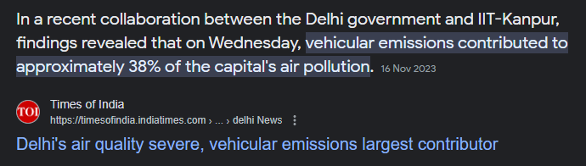
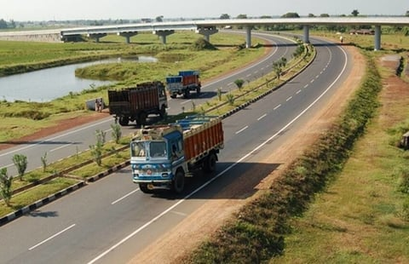
Source:
Digit Insurance
ET AUTO
Times of India
https://www.knocksense.com/

Slide 4
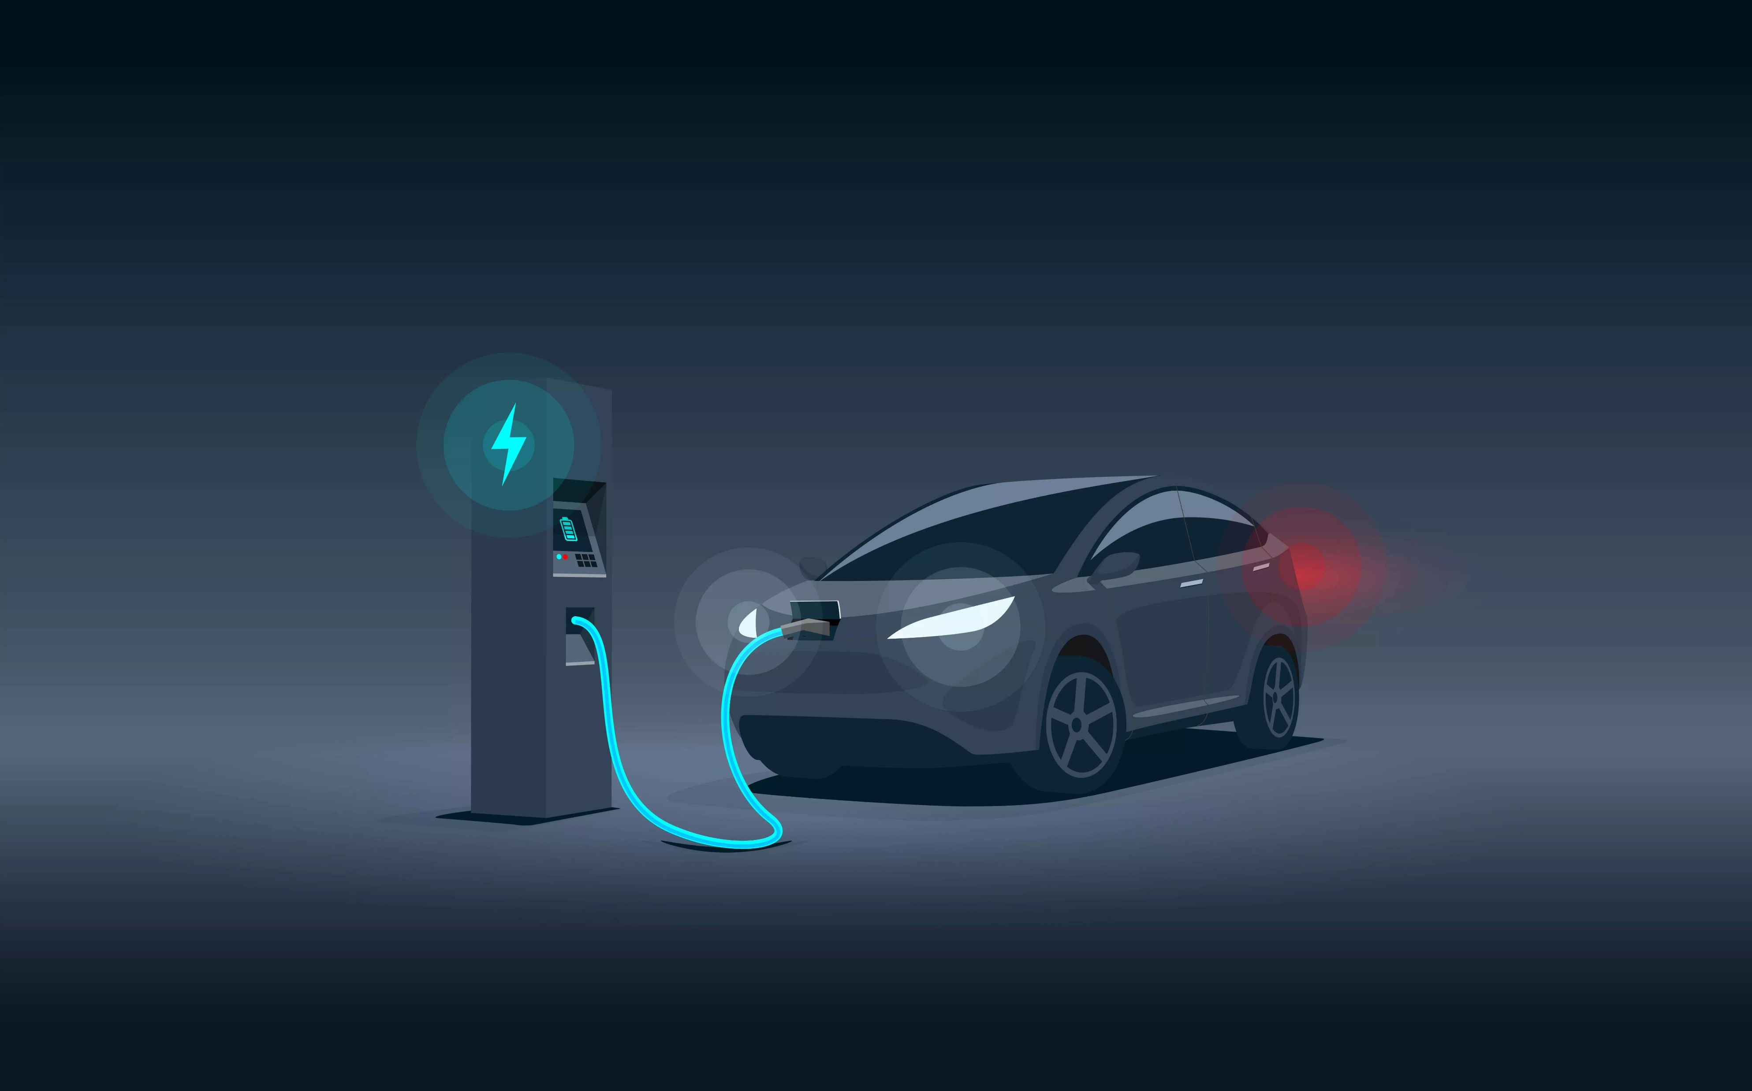
Are EVs Green?
Negative Environmental Impacts of EVs
By
Abhijeet Vaibhav
B.Tech. 3rd year
Source:
Google Images

Slide 5
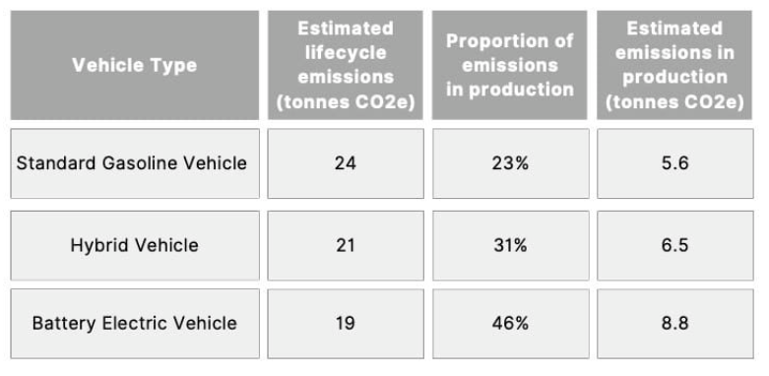
Vehicle Whole Life Carbon Emission Analysis
Source:
https://www.earth.org

Slide 6
EVs are Not Green
To produce one tonne of lithium (enough for ~100 car batteries) requires approximately 2 million tonnes of water, which makes battery production an extremely water-intensive practice.
In Chile, 65% of region water was used for lithium extraction.
Nickel and cobalt have similar reputations
Only 5% of the world’s total batteries are currently recycled
Nickel, cobalt, and lithium, which are finite resources, leading to even more environmental harm
Source:
https://www.iea.org

Slide 7
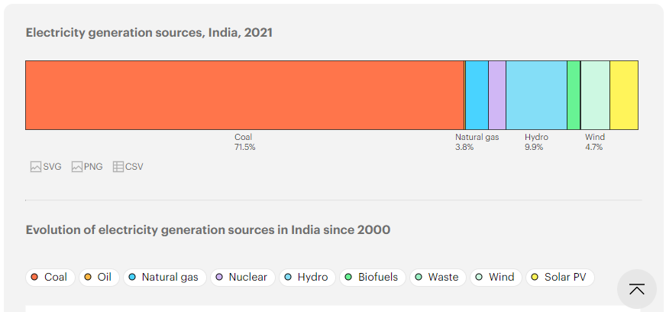
Distribution of electricity generation in India in 2022, by energy source
Source:
https://www.iea.org

Slide 8
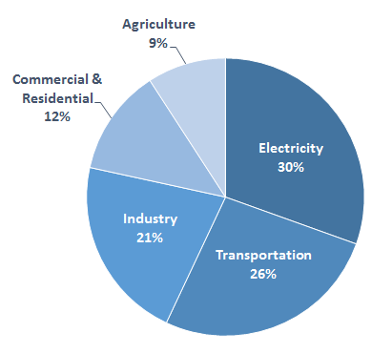
Total U.S. Green House Gas Emissions in 2014
Global energy-related CO₂ emissions grew by 1.1% in 2023, increasing 410 million tonnes (Mt) to reach a new record high of 37.4 billion tonnes (Gt). This compares with an increase of 490 Mt in 2022 (1.3%). Emissions from coal accounted for more than 65% of the increase in 2023.
Source:
https://www.climatechange.Chicago.gov

Slide 9
Negative Impacts of EVs on Environment
More rolling blackouts
Loss of biodiversity, air pollution and decreased freshwater supply
Mining could cause massive destruction, corrupt an already fragile ecosystem and pillage the country’s natural resources all in the name of “green progress”
EVs battery are not designed to be recycled (recycling methods are still in early stage)
buying tires more often
Source:
https://www.biofriendlyplanet.com

Slide 10
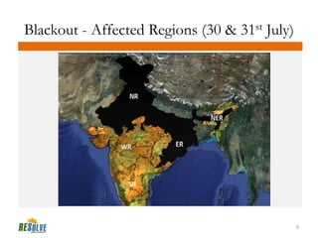
Indian blackouts of July 2012 – 30 and 31 July
On 30 and 31 July 2012, two large-scale power blackouts occurred in India, which can easily be termed as the worst power crisis ever in the history of mankind. The first of the two outages affected nearly 350 million people, while the second one involved a whooping 670 million people, one-tenth of the world’s population and spread over 21 out of 28 Indian states.
Source:
https://www.slideshare.net
https://medium.com

Slide 11
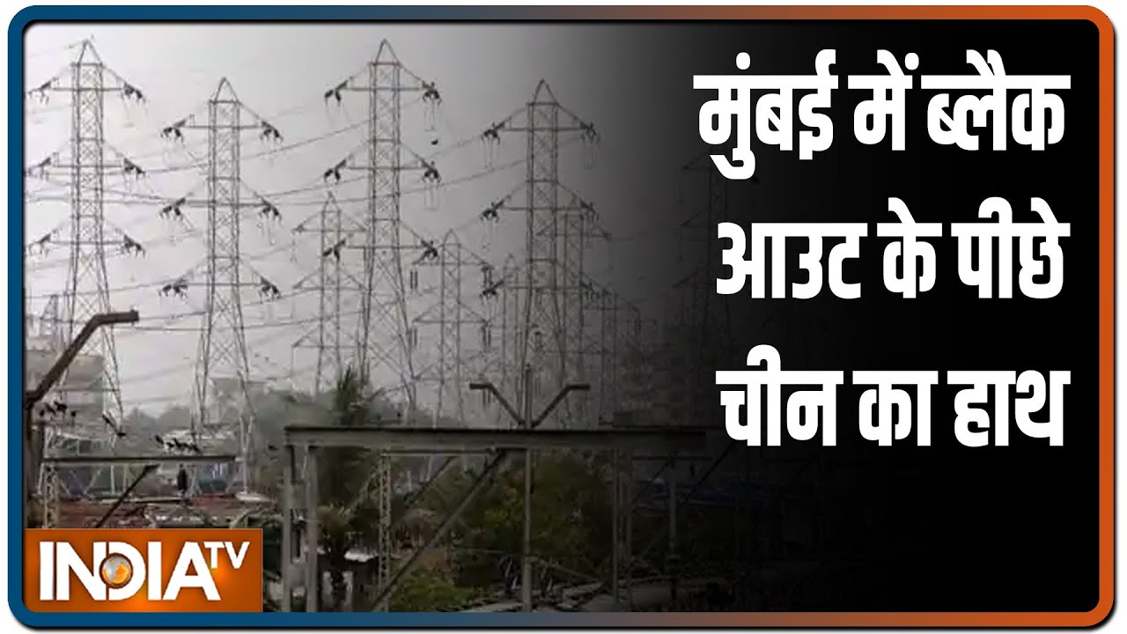
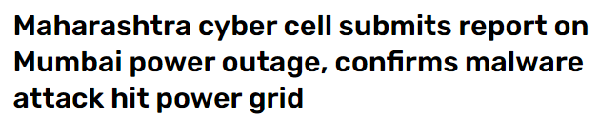
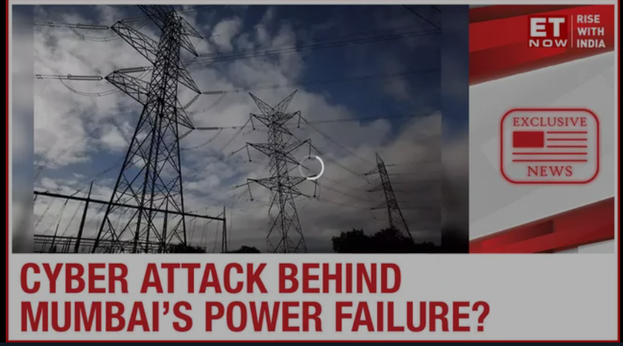
Mumbai Grid failure 2021
The 100-page report confirms a malware attack was behind the blackout and said that about 14 Trojan Horses and 8 GB of unaccounted data was found in the system, which according to the investigation was installed in the Maharashtra State Electricity Board (MSEB) system by unverified sources.
Source:
https://www.indiatoday.in/
https://www.timesnownews.com/
https://www.indiatvnews.com/

Slide 12


Conclusion
The main takeaway is EVs, in certain circumstances, can have an improved environmental impact vs. conventional gas-powered vehicles. However, batteries, charging and various manufacturing processes still negatively affect the environment. More work must be done to ensure these vehicles are as eco-friendly as possible.
Source:
https://www.nasa.gov

Slide 13
Any Question ?

